Slide 1

AI Strategies
We know that since the launch of ChatGPT and the integration of the same by Microsoft into their products have changed the game of AI completely.
In this presentation we will be going through what I think are the necessary action that should be taken to stand a good ground in this AI revolution.

Slide 2

What we will investigate in the presentation.
Analysis of Microsoft’s integration of AI in its products and services and how it a threat to Google’s business.
Analysis of Google’s current position as a Search engine after the launch of ChatGPT.
Challenges google is likely to face being a late mover in the AI war, and strategies to overcome them.

Slide 3

Furthermore:
Advantages Google holds against OpenAI in creating a better AI bot user experience.
Company’s primary target audience, its features and its mode of functionality.
Strategies to integrate AI to create new monetizable services and products within its ecosystem.

Slide 4

Microsoft’s use of AI thus far:
Azure OpenAI services: Microsoft has given developers the power to integrate ChatGPT into their applications through Azure OpenAI Service. In preview, this integration enables developers to enhance bots, expedite customer support resolutions by summarizing call center conversations, generate personalized ad copy, automate claims processing, and more.
Bing: Microsoft has already integrated GPT technology (generative pre-trained transformer – the “brain” of ChatGPT) into its Bing search
GitHub Copilot: Use of a modified version of GPT-3 specifically trained to write code – to provide autocomplete features for coders.
Teams: ChatGPT functions are enabled in Microsoft Teams, its collaborative working environment featuring virtual conferencing and video calling functionality

Slide 5
Microsoft’s use of AI thus far:
Windows 11 taskbar : Bing with ChatGPT has been added on the Windows 11 taskbar which makes it easier for Windows users to access the chatbot without opening the Microsoft Edge browser thus encouraging people to use Bing search engine.
Office 365: Microsoft had announced that ChatGPT will be integrated into Office 365 in late 2023. We can expect that to happen with the start of the next year. This integration will allow users to access ChatGPT directly from within Office 365, making it easier to get answers to questions and complete tasks.
Windows terminal: Windows Terminal is getting an optional feature – ChatGPT-powered “AI chat” on Windows 11. ChatGPT integration is now available in Terminal (Canary), a new development channel to test experimental features ahead of a wider rollout. With ChatGPT AI Chat in Terminal, you can use AI to generate commands, explain errors, and get recommendations

Slide 6

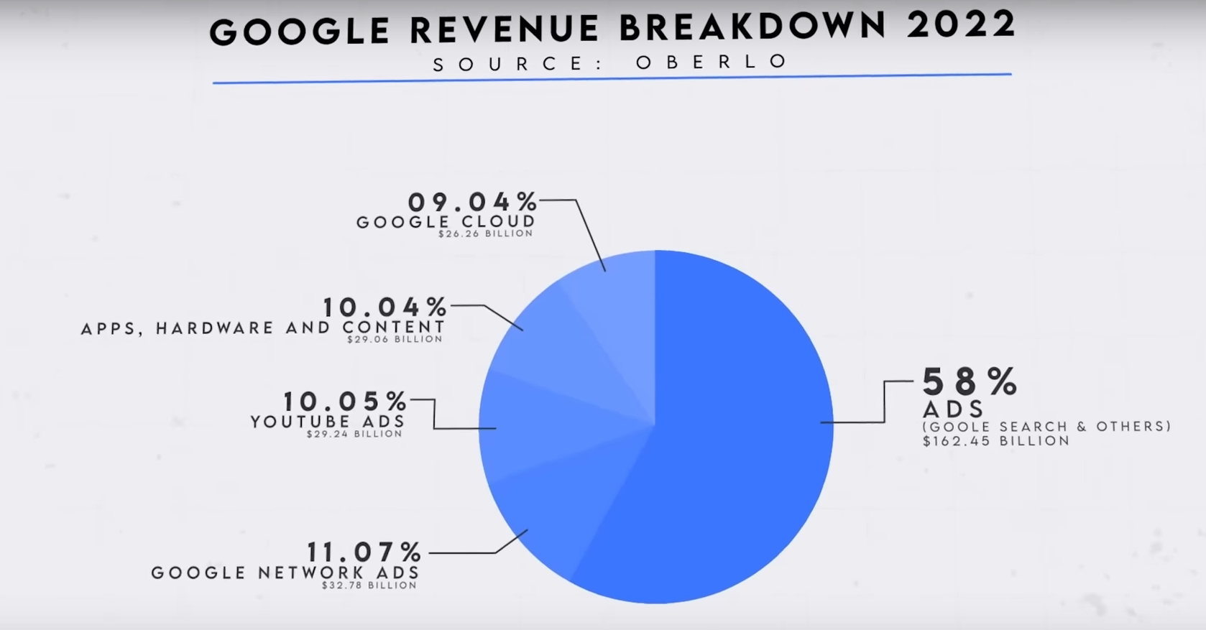
How it Threatens Google’s Business:
58% of Google’s revenue (as can be seen from the above pi-chart) comes from Ads from Google searches (and others). The integration of ChatGPT in Bing search engine makes it a competitor in the search engine market, thus threatening the most significant part of our company’s revenue.

Slide 7
Position of Google’s Search Engine after the launch of ChatGPT
ChatGPT can prove to be a competitor to Google assistant. While both applications use artificial intelligence and can understand natural language, ChatGPT is more conversational.
Market shares: Any impact of ChatGPT on Google’s search dominance is currently overblown, as ChatGPT only has 2% of Google’s monthly traffic. Despite the integration of ChatGPT, Bing market shares remains unimpressive.
Revenue: The greatest threat ChatGPT poses to Google is ad revenue. Because ChatGPT provides one answer, it is far less conducive to digital ads, which accounted for 80% of Google’s revenue last year. However, Google’s search revenues have remained stable so far, despite the rise in ChatGPT traffic.

Slide 8
Position of Google’s Search Engine after the launch of ChatGPT
Innovation: While Google Search excels in quick retrieving information from the web, ChatGPT is designed for more interactive and dynamic language-based tasks. The emergence of ChatGPT has prompted an industry-wide shift in AI and search engine development strategy.
Brand Image: Google’s founders have approved plans to add chatbot features to the search engine in response to the success of OpenAI’s ChatGPT. The pressure on Google is increasing due to the surge in attention surrounding ChatGPT.

Slide 9

Challenges Google is likely to face being a late mover in AI war:
OpenAI’s Opening Line Up: OpenAI, as first mover, has already secured several companies as customers, including Snapchat, Microsoft, and Duolingo, among others to embed ChatGPT into their core products. Thus, Google is likely to have a hard time converting or finding new customers.
A note on switching costs: These risks and drawbacks associated with switching providers are often referred to as switching costs. Switching costs explain why customers stick with inferior technology. Even if the new technology vastly outperforms, the cost of switching keeps customers glued to what they have.

Slide 10
Strategies to overcome mentioned Challenges:
Market Positioning: Google’s primary second-mover advantage is that they can position Gemini as an answer to ChatGPT’s inaccuracy. Thus, Google should work their best on overcoming failings of ChatGPT in their AI model.
Lower Computing Costs: By launching later, Google may also benefit from lower computing costs. Current generative AI companies have yet to establish profitable business models (as proclaimed by the CEO of OpenAI himself). This unprofitability is from generative AI’s heavy reliance on data centers and power, which skyrocket computing costs.

Slide 11
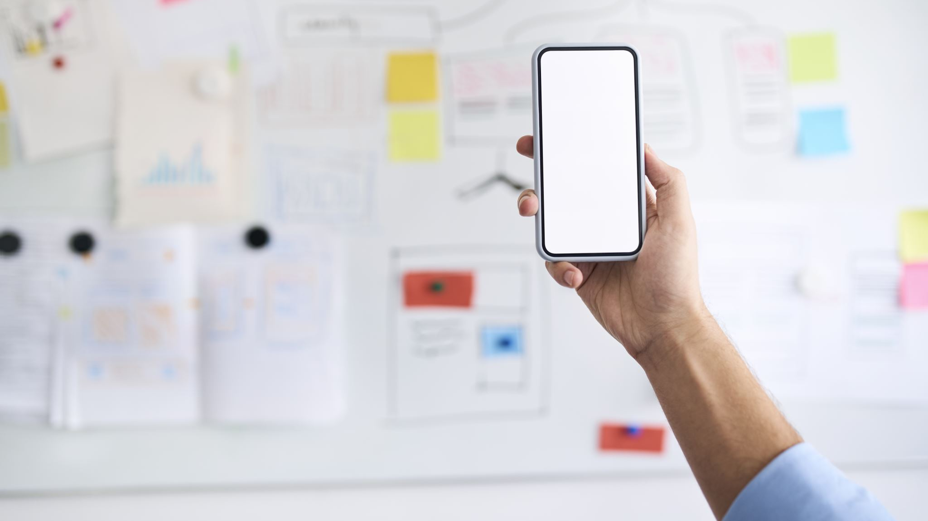
Advantages Google holds against OpenAI in creating a better AI bot user experience:
Gemini (the latest response from Google in the AI war) is a natively multimodal system, designed to process text, image, sound, and video from the start compared to ChatGPT which is a just multimodal system, designed primarily for text and added features later.
Google has its own vast dataset from YouTube, Google Books, and Google Scholar, giving Gemini an advantage in training its AI models.

Slide 12
Advantages Google holds against OpenAI in creating a better AI bot user experience:
Gemini outperformed ChatGPT in 30 out of 32 benchmarks, including a multitask language understanding benchmark. Google Gemini achieved 59.4% when benchmarked in MMMU (Multi-discipline college-level reasoning problems), whereas GPT-4V (GPT-4 with vision) reaches 56.8%.

Slide 13

Google’s Primary Target Audience:
General users: Bard is geared towards general users seeking information and engaging in open-ended conversations. It is thus, designed to be more accessible to individuals without extensive expertise in AI.
Professionals and Developers: Gemini potentially targets professionals and developers who need an AI tool for tasks like creative content generation, code translation, or data analysis across different formats. It is also designed to cater to creative industries, providing artists, designers, and content creators with tools for generating unique and realistic visual content.

Slide 14
Google’s Primary Target Audience:
Collaborators: Bard is being upgraded with Gemini Pro for new ways to collaborate with AI. It is expected to provide an improved, more intelligent user experience.
Advanced users: Bard Advanced, which gives first access to the most advanced models and capabilities starting with Gemini Ultra, targets users who are interested in cutting-edge AI experiences.

Slide 15
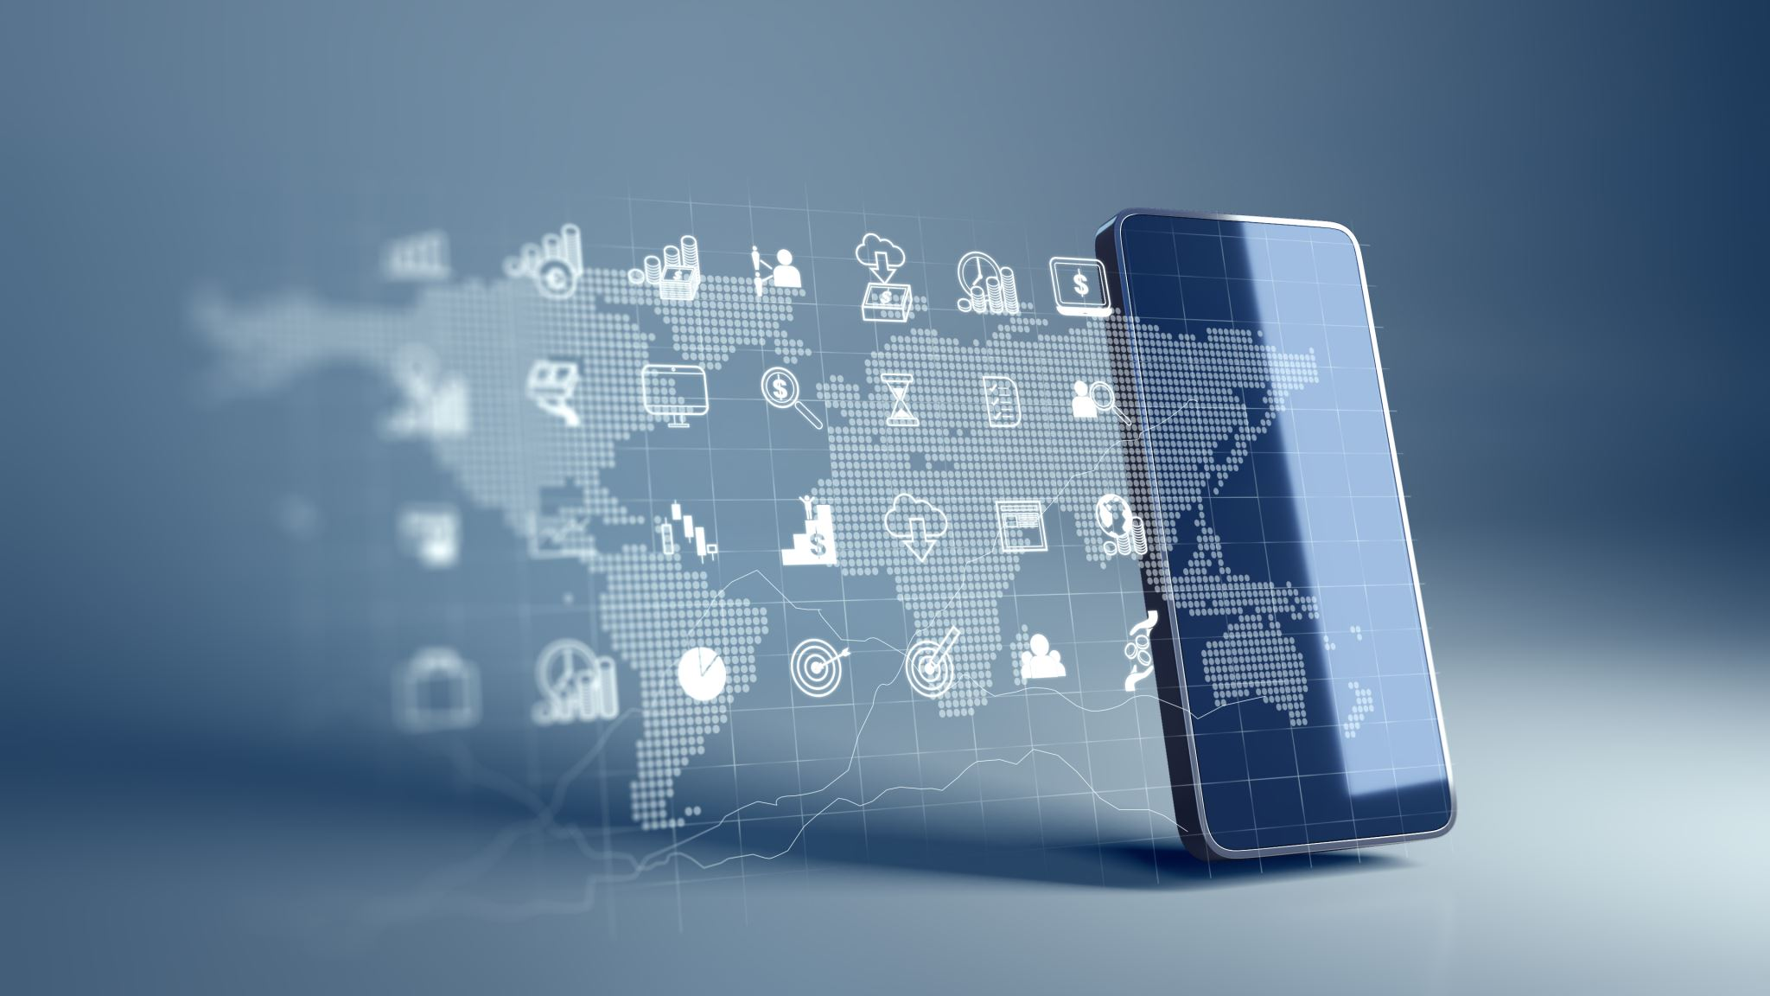
Company’s Features and its mode of Functionality:
Gemini comes in three versions: Nano, Pro, and Ultra. Nano is lightweight and can run on Android phones without the internet. Pro is the brain behind Google's AI services, including search engine capabilities. Ultra is designed for businesses and data centers.
Gemini is a natively multimodal system, designed to process text, image, sound, and video from the start compared to ChatGPT which is a just multimodal system, designed primarily for text and added features later.

Slide 16
Monetizing AI services and products within its ecosystem:
A big source of monetization will come from google search engine having most of the customers in search market which in turn will rise to revenue from google ads. Ai can help in personalizing ads and improving ad targeting.
Cloud Computing: Google is growing its share in the cloud market. The company is leveraging AI to enhance and streamline their business, smoothly and smartly. This feature could be provided to the customer for a premium.

Slide 17
Monetizing AI services and products within its ecosystem:
Transportation, Logistics, and Healthcare: Google is looking at industries ripe for disruption such as transportation, logistics and healthcare. AI can be used to optimize logistics improve healthcare outcomes and develop autonomous vehicles.
Emerging Markets: Google is expanding in India and Southeast Asia, and rebuilding presence in China. AI can help in understanding user behaviour and preferences in these markets, and tailor products and services accordingly.

Slide 18
Monetizing AI services and products within its ecosystem:
Mobile users: Mobile phone industry is especially big in Southeastern Asia; Google will not be missing the opportunity to bring AI to the mobile phone users. All of Google’s software will be compatible with both mobile and desktop environments. Incorporating Brad in Google assistant could be one big improvement in attracting mobile phone users and equipping them with AI capabilities.

Slide 19
CONCLUSION:
Even though Google is late into the AI race, the company can learn from the mistakes and failings of the current AI model (ChatGPT) to improve their Artificial Intelligence program.
Google will be competing not only to take back the customers it lost in search engine but also target companies and people looking to integrate AI in their programs to improve.
Google should focus on improving the AI’s abilities to not get outdated by the coming updates of ChatGPT.

